Slide 1
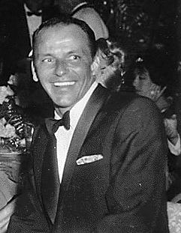
Salman Hasan Kanian
3/3/2012
12 F
Mrs. Timm
Frank Sinatra
http://en.wikipedia.org/wiki/File:Frank_Sinatra_laughing.jpg

Slide 2
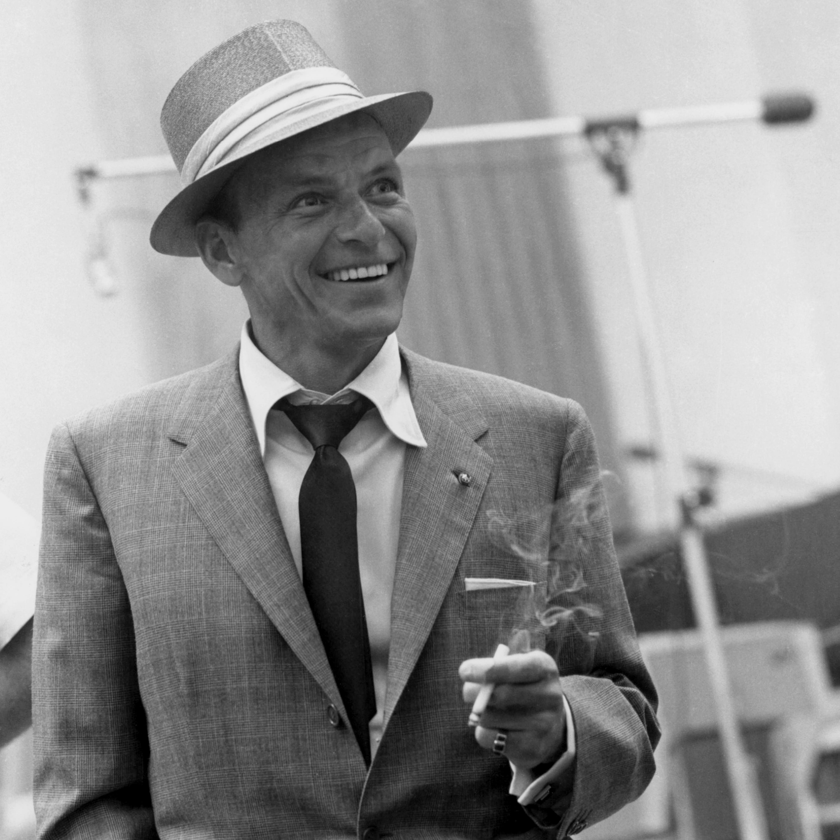
Introduction
Quote
Subject
Thesis Statement
http://totakethetrain.files.wordpress.com/2011/11/frank_sinatra_1.jpg
Notes:
Frank Sinatra quoted this and said “I would like to be remembered as a man who had a wonderful time living life, a man who had good friends, fine family - and I don't think I could ask for anything more than that, actually.”- Frank Sinatra My opinion of picking him is hes a great guy and for his legacy I did this presentation.
http://www.brainyquote.com/quotes/authors/f/frank_sinatra.html#ixzz1o4GtR1Bp

Slide 3
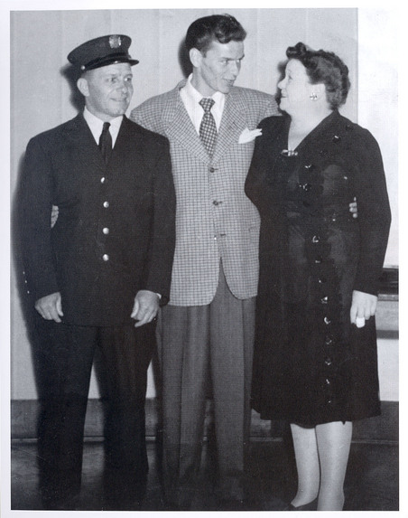
Birth
Date
Place
Family
http://blog.nj.com/hobokennow_impact/2007/11/large_sinatra_pignone_momanddad.jpg
Notes:
Francis Albert Sinatra was Born on the 12th of December, 1915. He was born in Hoboken, New Jersey U.S.
He was the only child of a Sicilian boxer and Hoboken Fire Department fireman, Anthony Martin Sinatra, and a Genoan midwife, Democratic party ward boss, and abortionist, Natalie "Dolly" Sinatra née Garaventa. His parents had immigrated to the United States in 1895 and 1897, respectively.

Slide 4
Education
School
Notes:
Francis Albert Sinatra left High School without Graduating. Having intended only 47 days, Being expelled due to his rowdy conduct.

Slide 5
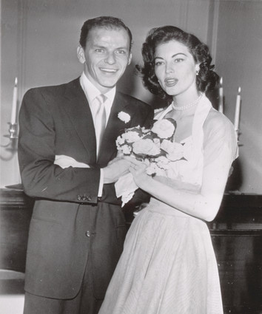
Marriages
Wife's
Children
Notes:
Frank Sinatra had 4 wife's His first wife was Nancy Barbato. 2nd wife was Eva Gardner. 3rd wife was Mia Farrow. 4th and last was Barbra Marx. Frank had had 3 kids, 2 girls and a son.

Slide 6
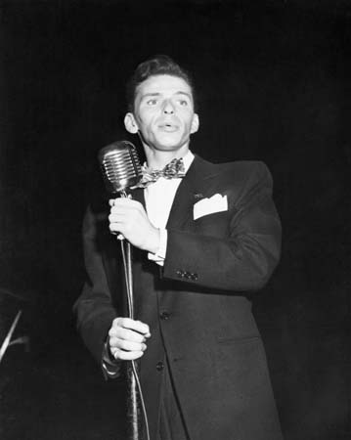
Career
Singing Career
http://madetm.files.wordpress.com/2009/08/pd5157289frank-sinatra-sings-a-87.jpg
Notes:
Beginning his musical career in the Swing Era along with Harry James and Tommy Dorsey, Sinatra became a highly successful solo artist, releasing 59 studio albums and becoming the idol of the ‘bobby soxers’.

Slide 7
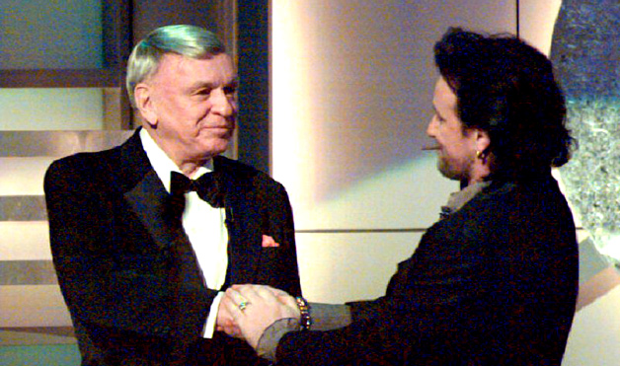
Achievements
Awards received
Notes:
Frank Sinatra was the recipient of eleven Grammy Awards, including the Grammy Trustees Award, Grammy Legend Award and the Grammy Lifetime Achievement Award. Sinatra was also honored at the Kennedy Center Honors in 1983 and was awarded the Presidential Medal of Freedom by Ronald Reagan in 1985, and the Congressional Gold Medal in 1997.

Slide 8
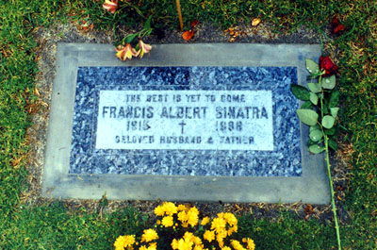
Death
Where
How
When
Buried
http://s3.amazonaws.com/findagrave/photos/2001/222/sinatrafrankmine.jpg
Notes:
Frank Sinatra died at the Cedars-Sinai Medical Center, after Suffering from another Heart attack. at10:50 pm on May 14,
1998, at the age of 82. He was buried a short distance east of St. Theresa's, next to his parents in section A-8 of Desert Memorial Park in Cathedral City.

Slide 9
Conclusion
My point of view
Notes:
In my opinion Frank Sinatra, was a great guy who made it from nothing to the fame. And he did and got lots of things in life. which is a fine example of living the american dream. And id love to achieve such success as Frank Sinatra.

Slide 10
Work Cited
BrainyQuote. Xplore. Web. 01 Mar. 2012. <http://www.brainyquote.com/quotes/authors/f/frank_sinatra.html>.
"Frank Sinatra Biography." 1990. Web. 04 Mar. 2012. <http://sinatrafamily.com/biography/1990/>.
"Frank Sinatra Biography." 1915. Web. 04 Mar. 2012. <http://sinatrafamily.com/biography/1915/>.
"Frank Sinatra Biography." 1940. Web. 02 Mar. 2012. <http://sinatrafamily.com/biography/1940/>.

Slide 11
Work Cited
"Frank Sinatra Biography." 1950. Web. 03 Mar. 2012. <http://sinatrafamily.com/biography/1950/>.
"Frank Sinatra Biography." 1960. Web. 04 Mar. 2012. <http://sinatrafamily.com/biography/1960/>.
"Frank Sinatra Biography." 1970. Web. 01 Mar. 2012. <http://sinatrafamily.com/biography/1970/>.
"Frank Sinatra's Love and Marriages." NY Daily News. Web. 04 Mar. 2012. <http://www.nydailynews.com/entertainment/music-arts/frank-sinatra-love-marriages-article-1.329594>.

